Slide 1

Amazon Rekognition Should Diversity Data and Strengthen Management
Lucy Cui

Slide 2
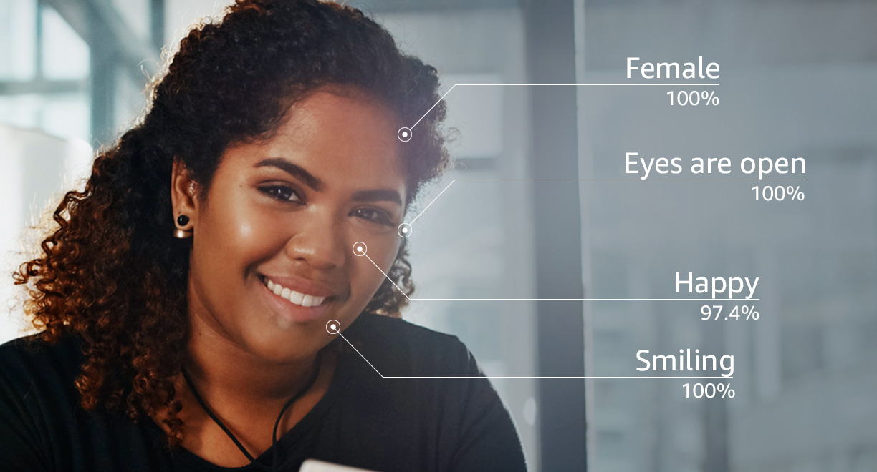
Amazon Rekognition
Computer vision (CV) capabilities
Extract information and insights from your images and videos
Face compare and search
Face detection and analysis
Celebrity recognition

Slide 3
Menu
Ethical issues
Recommendations
Decision-making

Slide 4
Bias & Discrimination
Gender
Race
People with headgear
Age

Slide 5
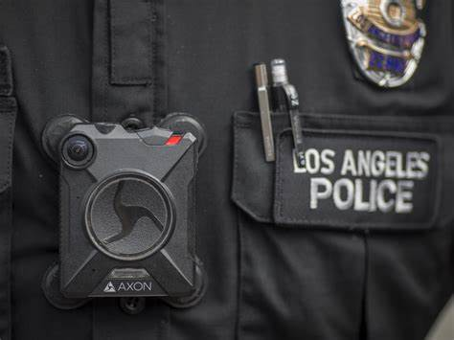
Privacy
Used by law enforcement agencies
Surveillance apparatus
Body cameras
Intrude privacy
Abuse human rights

Slide 6
Safety
Systems breached in 20 minutes
Identify the host as Schwarzenegger
Database
Unique biometric data is at risk

Slide 7

Recommendations
Diversify training data, regularly test for bias
Limit access
Provide ethical guidelines, get consent
Implement firewall, encryption
Train employees

Slide 8
Decision making
Lack of careful consideration
Bias in collecting data
Poor usage management
Imperfect system

Slide 9
Conclusion

Slide 10
Reference
https://aws.amazon.com/rekognition/?nc1=h_ls
https://journals.sagepub.com/doi/pdf/10.1177/2378023120967171
https://openaccess.thecvf.com/content_ICCV_2019/papers/Wang_Racial_Faces_in_the_Wild_Reducing_Racial_Bias_by_Information_ICCV_2019_paper.pdf
https://ictinstitute.nl/wp-content/uploads/2020/01/Thesis_Final_EthicsAI_JTol.pdf
https://dl.acm.org/doi/abs/10.1145/3461702.3462609
https://heinonline.org/HOL/LandingPage?handle=hein.journals/iprop25&div=20&id=&page=
https://www.cnet.com/home/smart-home/what-is-amazon-rekognition-facial-recognition-software/
https://www.yicai.com/news/100045603.html

Slide 11
THANKS

